Slide 1
Fall 2018 Senior Design Project
Leader: Zane Saul
Emmanuel Anih
Clare Collins
Victor Hernandez
AJ Krawczyk
Matthew Morey
Spencer Roberts

Slide 3
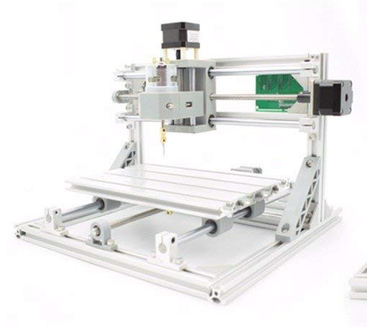
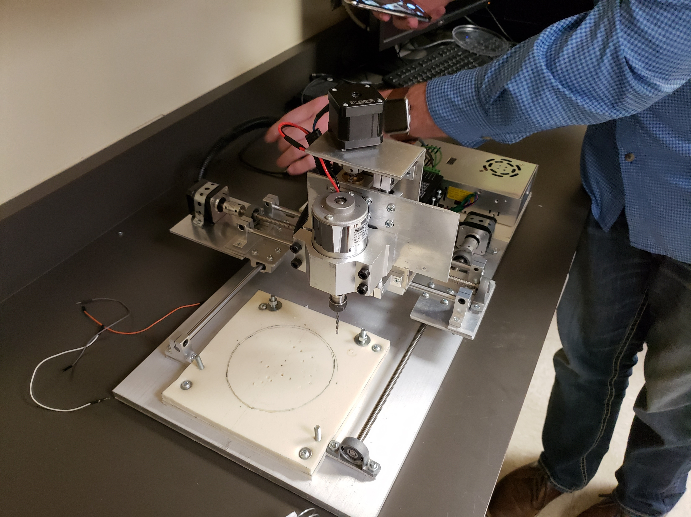
General Concept

Slide 4
Parts
Qty | Part Type
15’ | T-Shafts, Aluminum
4 | Lock Support Clamps
2 | Bearing Clamps (threaded shaft)
2 | Support Bars
1 | Threaded Support Bar
4 | Side Bushings
1 | Threaded Lock Bushing
4 | 90˚ Support
2 | Large 90˚ Support
2 | Alt Bar

Slide 5
Timeline
Sep. 28: Parts List Due
Oct. 26: Frame Assembled
Nov. 16: X/Y/Z Axis Complete
Dec. 3: Motors Complete
Dec. 7: Alexa Software Compatibility
Dec. 8: Final Completion Date

Slide 6
Individual Tasking
Zane: Leader, Software and Electronics
Matthew: Mechanic Lead, Frame Design
Spencer: Co-Leader, Environmental Analysis
AJ: Design Lead, Parts Lists
Emmanuel: Mechanical Assembly
Clare: Mechanical Assembly
Victor: Mechanical Assembly

